Slide 1
#TranslatingEurope Workshop
Translator Skills and Employability
Follow the seminar: #TranslatingEurope #LanguageShow
Twitter: @Translatores / @ITIUK / @CIOLinguists
Chair: Paul Kaye, European Commission Representation in the UK Panellists: Klaus Ahrend, European Commission Directorate-General for Translation Begona Rodríguez, Portsmouth University Nicholas Nicou, freelance translator James Powell, Department Manager, Transperfect

Slide 2
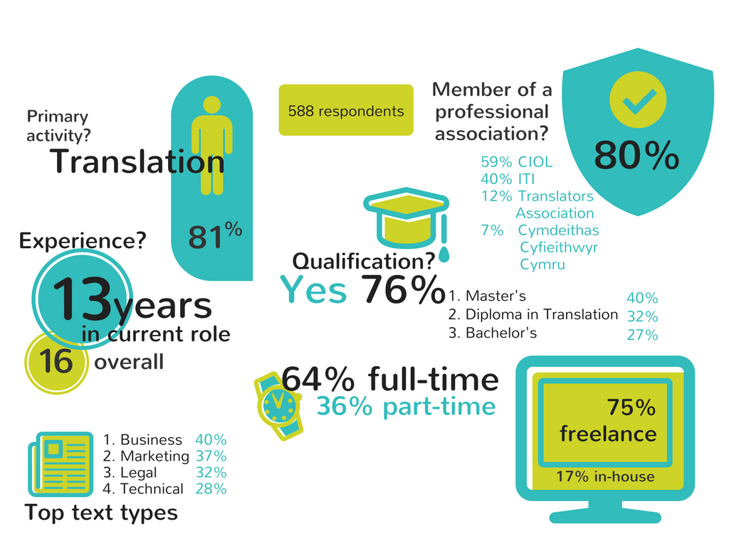
European Commission | Chartered Institute of Linguists | Institute of Translation and Interpreting

Slide 3
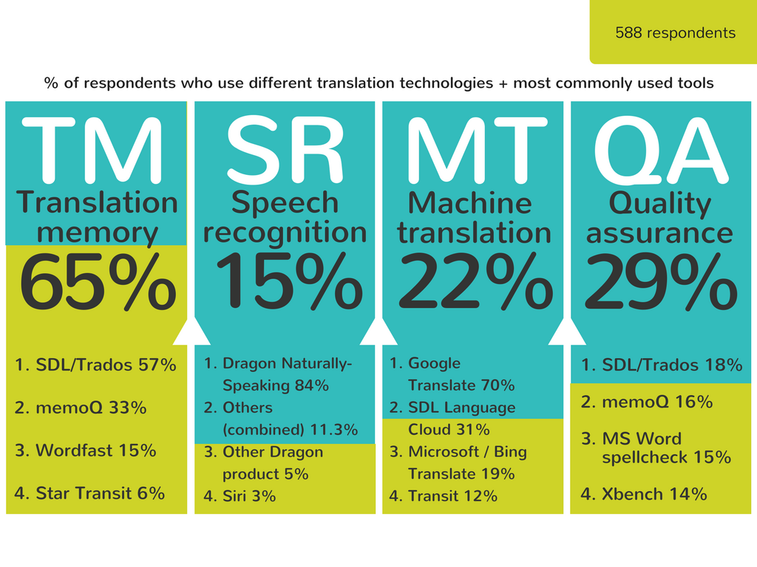
European Commission | Chartered Institute of Linguists | Institute of Translation and Interpreting

Slide 4
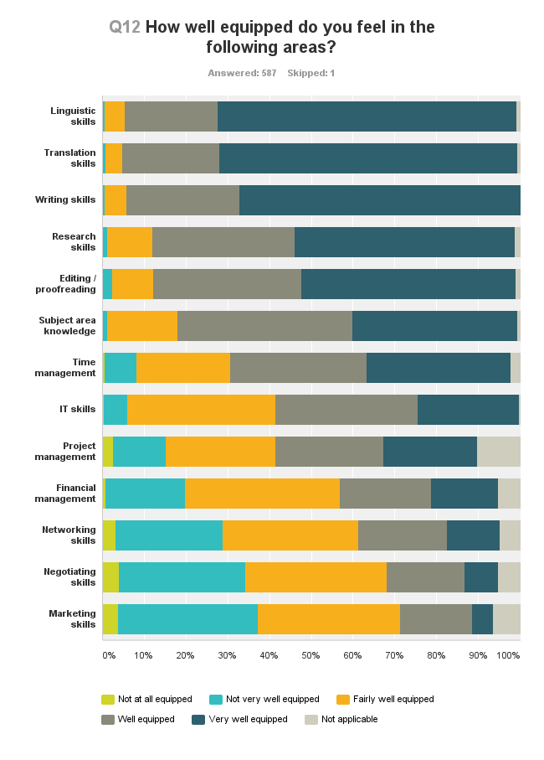

Slide 5
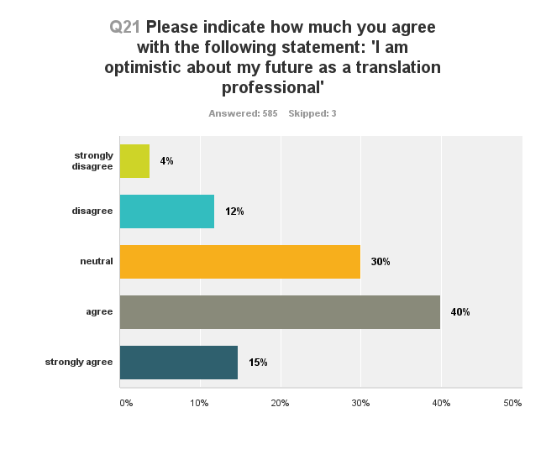

Slide 6
#TranslatingEurope Workshop
Translator Skills and Employability
Follow the seminar: #TranslatingEurope #LanguageShow
Twitter: @Translatores / @ITIUK / @CIOLinguists
Chair: Paul Kaye, European Commission Representation in the UK Panellists: Klaus Ahrend, European Commission Directorate-General for Translation Begona Rodríguez, Portsmouth University Nicholas Nicou, freelance translator James Powell, Department Manager, Transperfect

