Slide 1
TRANSLATOR SKILLS & EMPLOYABILITY Round-table, Translating Europe National Workshop, 14 October 2017
Begoña Rodríguez de Céspedes
MA Translation Studies Course Leader

Slide 2
What is employability?

Slide 3
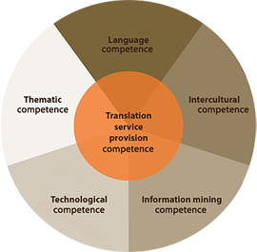
Skills or competences?
Ongoing debate in Academia
European Master’s in Translation Competences:

Slide 4
Life-long learning
www.clipartbest.com

Slide 5
Bibliography
Rodríguez de Céspedes et al. (eds) (2017) Special issue of the Interpreter and the Translator Trainer “Employability and the Translation and Interpreting Curriculum”, 11(2, 3)
Cole, D. and Tibby M (2013) Defining and Developing your Approach to Employability: A Framework for Higher Education Institutions. The Higher Education Academy.
EMT (2009) EMT Competences for Professional Translators, Experts in Multilingual and Multimedia communication. Retrieved from: http://ec.europa.eu/dgs/translation/programmes/emt/key_documents/emt_competences_translators_en.pdf

Slide 6
Begona.rodriguez@port.ac.uk www.port.ac.uk/translation

